Slide 1
Cass River Water Quality Monitoring Project
Year Two Project Summary
Prepared by: Environmental Science Solutions, LLC
June 2014

Slide 2
Project Background and Goals
The Cass River Greenway (CRG) organization contracted Environmental Science Solutions (ESS) to assist with fulfillment of its obligations pursuant to the Cass River Water Quality Monitoring Project grant (Project # 2011-0501) issued by the State of Michigan Department of Environmental Quality – Water Resources Division – Office of Surface Water Assessment.
The main goal of the project is to provide current baseline information to help determine watershed conditions along the main channel of the Cass River. Data and information from this project will be used to complement the current Cass River Watershed Management Plan and provide community members and stakeholders information about water quality within the study area.

Slide 3
Project Study Area
The study area for the project is the main channel of the Cass River on the northern boundary of the Cass River Watershed from Cass City in the northeast to Bridgeport in the southwest in east central lower Michigan. Nine sampling sites are located near the municipalities of Cass City, Caro, Vassar, Frankenmuth and Bridgeport in Tuscola and Saginaw counties. (See site map on next slide).

Slide 4
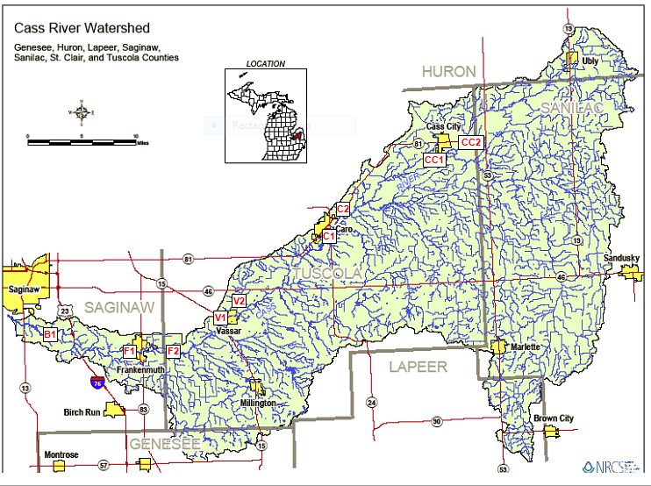
Project Study Area

Slide 5
Sample Sites
Site Name | Site ID | Municipality | County | Latitude | Longitude | Watershed
Cemetery Rd. | CC2 | Cass City | Tuscola | 43.5847 | -83.1736 | Cass River
Dodge Rd. | CC1 | Cass City | Tuscola | 43.5698 | -83.2321 | Cass River
Dayton Rd. | C2 | Caro | Tuscola | 43.4901 | -83.3765 | Cass River
Wells Rd. | C1 | Caro | Tuscola | 43.4503 | -83.4401 | Cass River
Caine Rd. | V2 | Vassar | Tuscola | 43.3924 | -83.5222 | Cass River
Huron Rd. | V1 | Vassar | Tuscola | 43.3712 | -83.5803 | Cass River
Bray Rd. | F2 | Frankenmuth | Tuscola | 43.3244 | -83.6572 | Cass River
Beyer Rd. | F1 | Frankenmuth | Saginaw | 43.3287 | -83.7584 | Cass River
Fort Rd. | B1 | Bridgeport | Saginaw | 43.3486 | -83.8844 | Cass River

Slide 6
Sample Parameters
Total Phosphorus
Total Suspended Solids
Fecal Coliform Bacteria
Nitrates
Turbidity
Temperature
pH
Dissolved Oxygen
Biological Oxygen Demand

Slide 7
Year Two Sampling Summary Highlights
2013 Sampling season began about 3 weeks earlier than 2012 (Early- April vs. May)
2013 was a bit cooler and wetter sampling season. More significant rain events.
Variation from 2012 to 2013 includes:
Increased Phosphorus levels in the upper and lower reaches of the sampling area.
pH Values were lower throughout the sample area.
Nitrate Values were down throughout the sample area. Elevated values occurred throughout the sample area on the 4/24 sample date.
Total Suspended solids and Turbidity values were elevated in all but the Fort Rd. site (B1).
Biological Oxygen Demand values were increased at all sites

Slide 8
Sample Results – Year Two
Site Name | Phosphorous | Total Suspended Solids | Fecal Coliform Bacteria | Nitrates | Turbidity | Temperature | pH | Dissolved Oxygen | Biochemical Oxygen Demand
Geometric Mean | mg/L | mg/L | Col / 100 ml | mg/L | NTU | ° F | Units | mg/L | mg/L
Cemetery Rd. (CC2) | 0.06 | 11.6 | 129 | 2.79 | 10.2 | 62.5 | 7.9 | 6.47 | 2.15
Dodge Rd. (CC1) | 0.05 | 9.0 | 175 | 2.55 | 9.1 | 62.6 | 7.9 | 6.57 | 2.44
Dayton Rd. (C2) | 0.007 | 14.5 | 94 | 2.63 | 14.9 | 63.5 | 8.0 | 6.23 | 2.38
Wells Rd. (C1) | 0.01 | 23.3 | 90 | 2.80 | 26.2 | 64.1 | 8.0 | 6.38 | 2.05
Caine Rd. (V2) | 0.05 | 13.6 | 55 | 2.71 | 13.9 | 63.2 | 8.0 | 6.49 | 2.16
Huron Rd. (V1) | 0.05 | 13.3 | 58 | 2.99 | 13.5 | 64.2 | 8.1 | 6.12 | 1.81
Bray Rd. (F2) | 0.10 | 13.9 | 189 | 2.10 | 10.2 | 64.3 | 8.1 | 6.24 | 1.96
Beyer Rd. (F1) | 0.10 | 20.2 | 163 | 2.11 | 13.5 | 64.6 | 8.0 | 6.20 | 2.03
Fort Rd. (B1) | 0.11 | 15.6 | 83 | 2.62 | 15.8 | 66.2 | 8.1 | 6.21 | 1.71
Study Area Geometric Mean | 0.04 | 14.46 | 105 | 2.57 | 13.50 | 63.90 | 8.00 | 6.32 | 2.06

Slide 9
Annual Comparison

Slide 10
Mean Value Comparison - Phosphorous

Slide 11
Mean Value Comparison - TSS

Slide 12
Mean Value Comparison – Fecal Coliform

Slide 13
Mean Value Comparison – Nitrates

Slide 14
Mean Value Comparison – Turbidity

Slide 15
Mean Value Comparison – Temperature

Slide 16
Mean Value Comparison – pH

Slide 17
Mean Value Comparison – Dissolved Oxygen

Slide 18
Mean Value Comparison– Biochemical Oxygen Demand

Slide 19
Water Quality Index (WQI) Summary
Water Quality Index Range
WQI Value Rating
90 - 100 Excellent
70 - 90 Good
50 - 70 Medium
25 - 50 Poor
0 - 25 Very Poor

Slide 20
Water Quality Index (WQI) Summary

Slide 21
Water Quality Index (WQI) Summary

Slide 22
Water Quality Index (WQI) Summary
Site Name | 2012 Site WQI | 2013 Site WQI | Percent Change | 2013 WQI Rank | 2012 WQI Rank | Net Rank Change
Cemetery Rd. (CC2) | 76.0 | 76.1 | 0.13% | 6 | 7 | -1
Dodge Rd. (CC1) | 76.8 | 75.6 | -1.6% | 7 | 3 | -4
Dayton Rd. (C2) | 78.0 | 77.1 | -1.2% | 4 | 1 | -3
Wells Rd. (C1) | 77.1 | 76.2 | -1.3% | 5 | 2 | -3
Caine Rd. (V2) | 76.3 | 77.7 | 1.9% | 2 | 4 | 2
Huron Rd. (V1) | 76.1 | 77.9 | 2.3% | 1 | 5 | 4
Bray Rd. (F2) | 75.4 | 75.4 | -0.1% | 9 | 8 | -1
Beyer Rd. (F1) | 73.9 | 75.5 | 2.2% | 8 | 9 | 1
Fort Rd. (B1) | 76.0 | 77.5 | 1.9% | 3 | 6 | 3
Mean Value | 76.2 | 76.5 | 0.5%

Slide 23
Water Quality Standard (WQS) Summary
Under weather conditions encountered, all sites met all statutory and generally accepted water quality standards. However, analysis indicated that heavy rain events and high temperatures can adversely affect bacteria levels.
All parameters for all sample all sites met state and EPA standards and scored in the good to excellent range in developed Water Quality Index standards.
Total suspended solids, nitrates, turbidity and Biochemical Oxygen Demand fall into the non-regulated category. Standards for these parameters are developed based on generally accepted water quality monitoring principles and practices.
Locally and Developed standards apply to E. Coli. This project measured fecal coliform. E. Coli is a subset of fecal coliform. Generally fecal coliform levels were below any thresholds that are a cause for public health concerns.

Slide 24
Observations and Conclusions
The overall increase in solids, turbidity, phosphorous and fecal in year two is likely due to the timing and intensity of precipitation throughout the study area. Second year sampling saw more and heavier rainfall events during sampling days.
The decline in temperature in year two can largely be attributed to the earlier sampling season start date. Water temperature was significantly cooler during the April sampling events.
The decline in pH in year two can likely be attributed mainly to the earlier sampling season start date. Research shows that pH increases with water temperature. Additionally, early season runoff may contain snow melt which can be lower in pH than ambient river water. pH was lower throughout the watershed throughout the sampling season.
Increased DO and BOD levels in year two also follow from increased flow. Again, the timing and intensity of precipitation supports the increase in these parameters during year two.

Slide 25
Recommendations
Extend sample season from early spring through late fall to capture seasonal variations in water chemistry.
Vary sample times within sample days to capture diurnal variation in sample parameters.
Conduct additional testing after rain events and during high temperatures to determine changes from steady state conditions
Investigate seasonal variation in pH – lower pH in early spring sample events.
Reducing flow rates from overland runoff during major rain events is key to slowing flow and reducing phosphorous and sediment loading levels.
Remain aware of DEQ’s potential action regarding tributary stream E. Coli standards (possible tributary studies including E. Coli and benthic monitoring) (Grant Opportunities).

Slide 26
Project Partners
Cass River Greenway
Michigan Department of Environmental Quality
Cass City Municipal Wastewater Treatment Facility
Caro Municipal Wastewater Treatment Facility
Vassar Municipal Wastewater Treatment Facility
Frankenmuth Municipal Wastewater Treatment Facility
Saginaw Valley State University
Environmental Science Solutions, LLC

Slide 27
References
Clair N. Sawyer, Perry L. McCarty, Gene F. Parkin (2003). Chemistry for Environmental Engineering and Science (5th ed.). New York: McGraw-Hill. ISBN 0-07-248066-1.
M. Mitchell, W. Stapp (2008). Field Manual (13th Edition) for Water Quality Monitoring. University of Michigan.
Correll, D.L (1998) Phosphorous: A rate Limiting Nutrient in Surface Waters. Edgewater Maryland Smithsonian Environmental Research Center.
Pfaffenberger, Roger C., Patterson, James H. 1977. Statistical Methods for Business and Economics. Irwin-Dorsey Limited, Georgetown, Ontario.
EPA 440/5-86-001, Quality Criteria for Water 1986.
Michigan Administrative Code, Part 4. Water Quality Standards. Rule 323.1041

